Slide 1
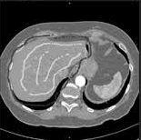

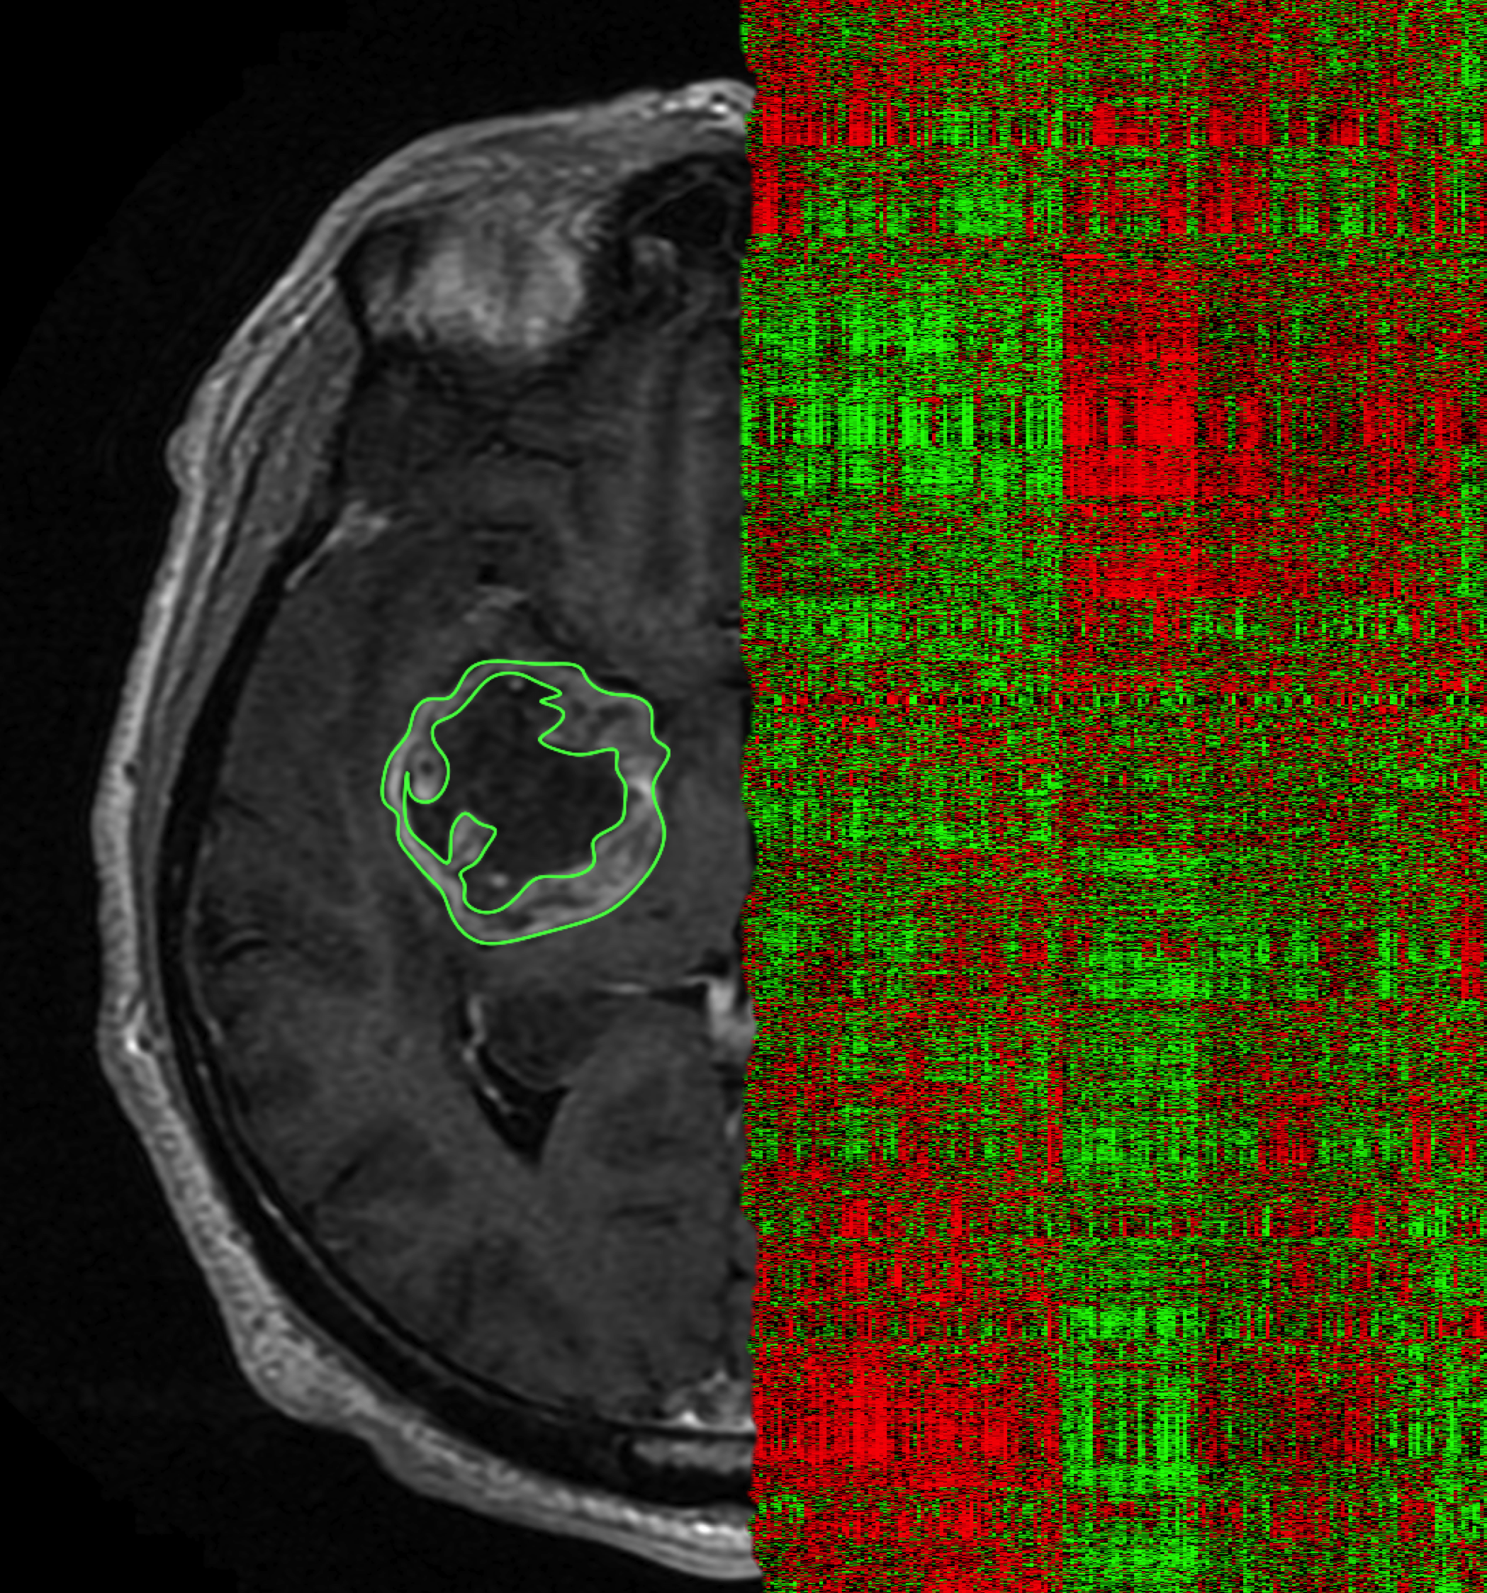


Raw Data
Standardize
Radiomics
ICC
Classification

